Slide 1
UNIT 4

Slide 2
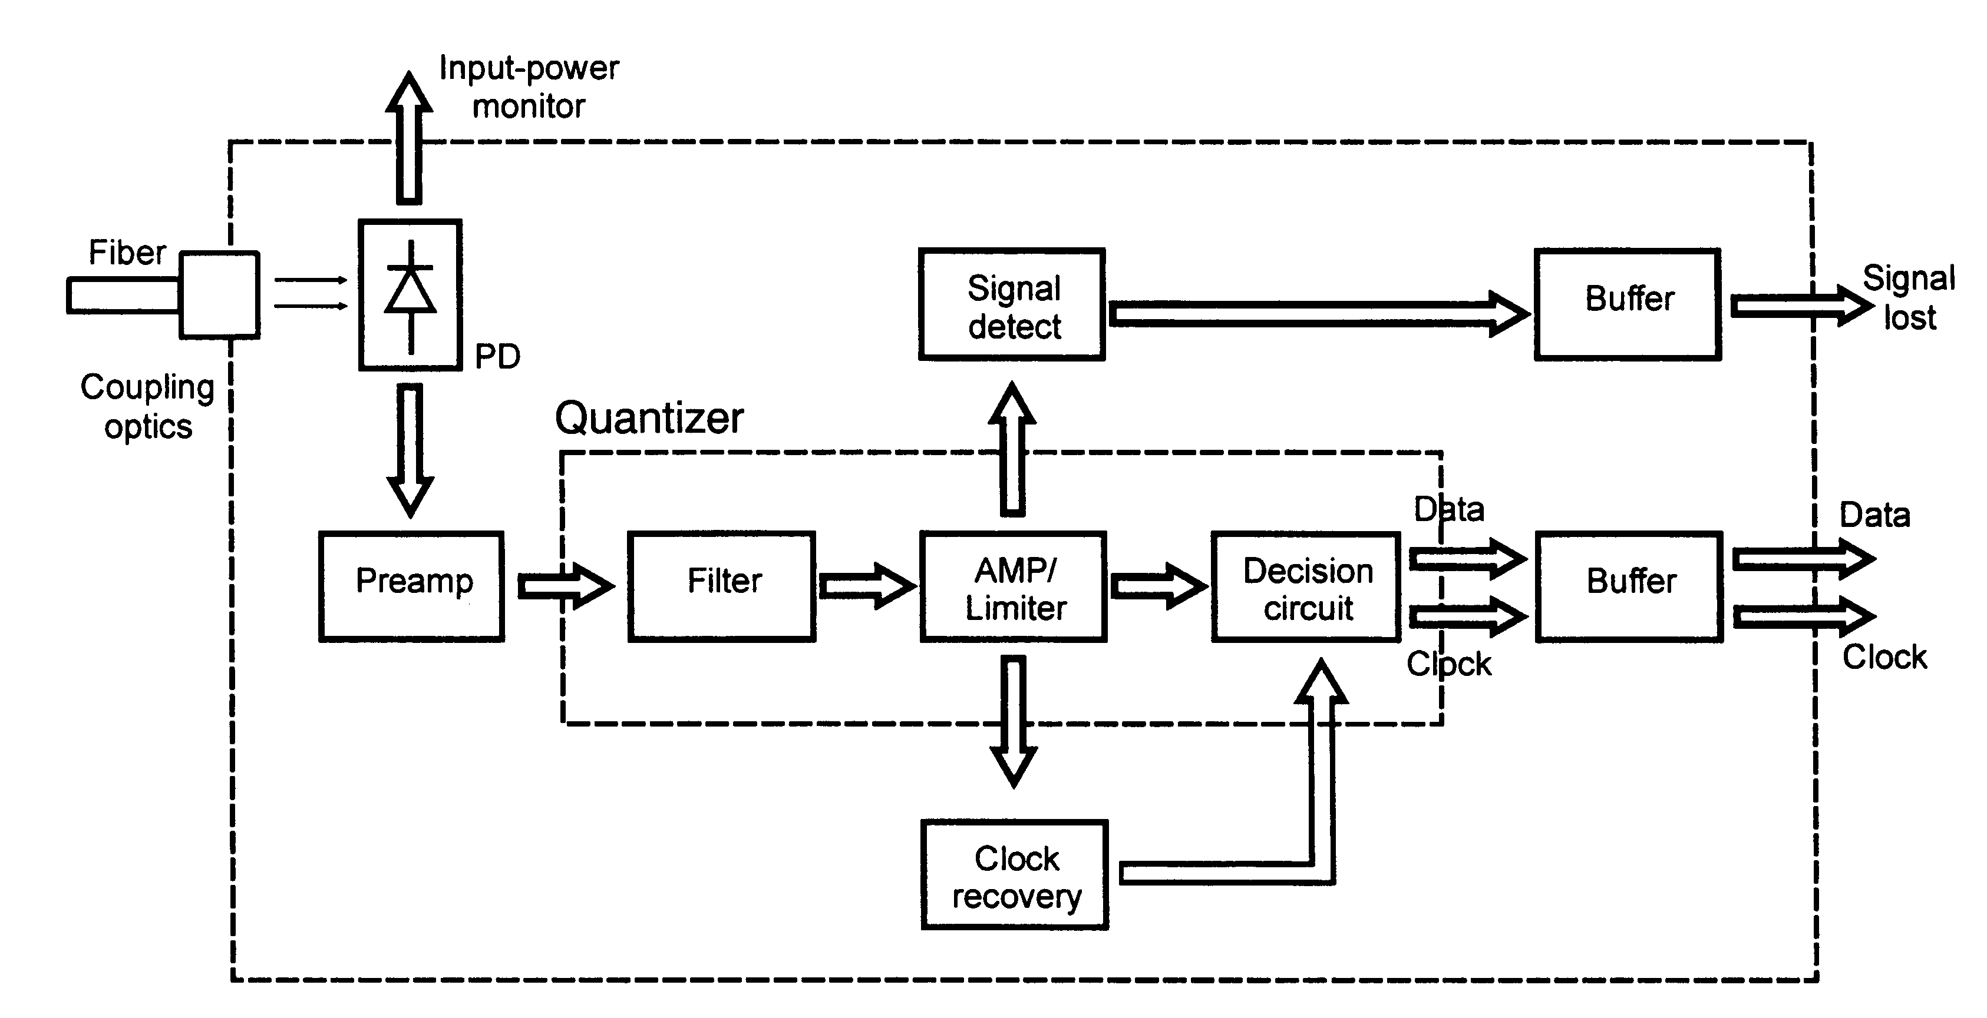
Receiver Functional Block Diagram
Fiber-Optic Communications Technology-Mynbaev & Scheiner

Slide 3
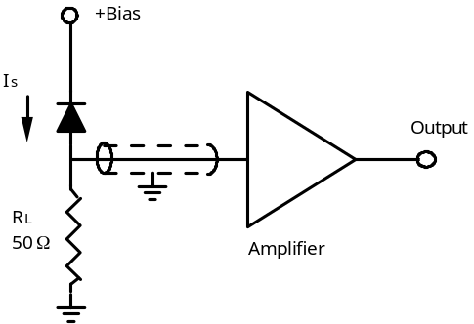
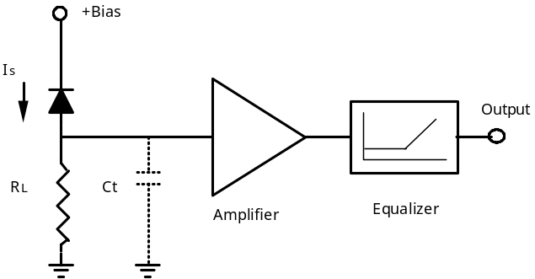
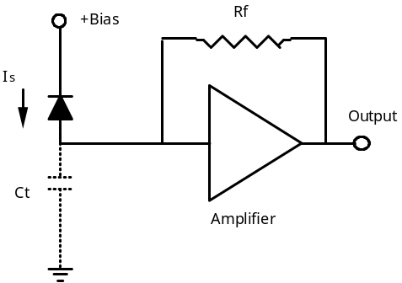
Receiver Types
Low Impedance
Low Sensitivity
Easily Made
Wide Band
High Impedance
Requires Equalizer for high BW
High Sensitivity
Low Dynamic Range
Careful Equalizer Placement Required
Transimpedance
High Dynamic Range
High Sensitivity
Stability Problems
Difficult to equalize

Slide 4
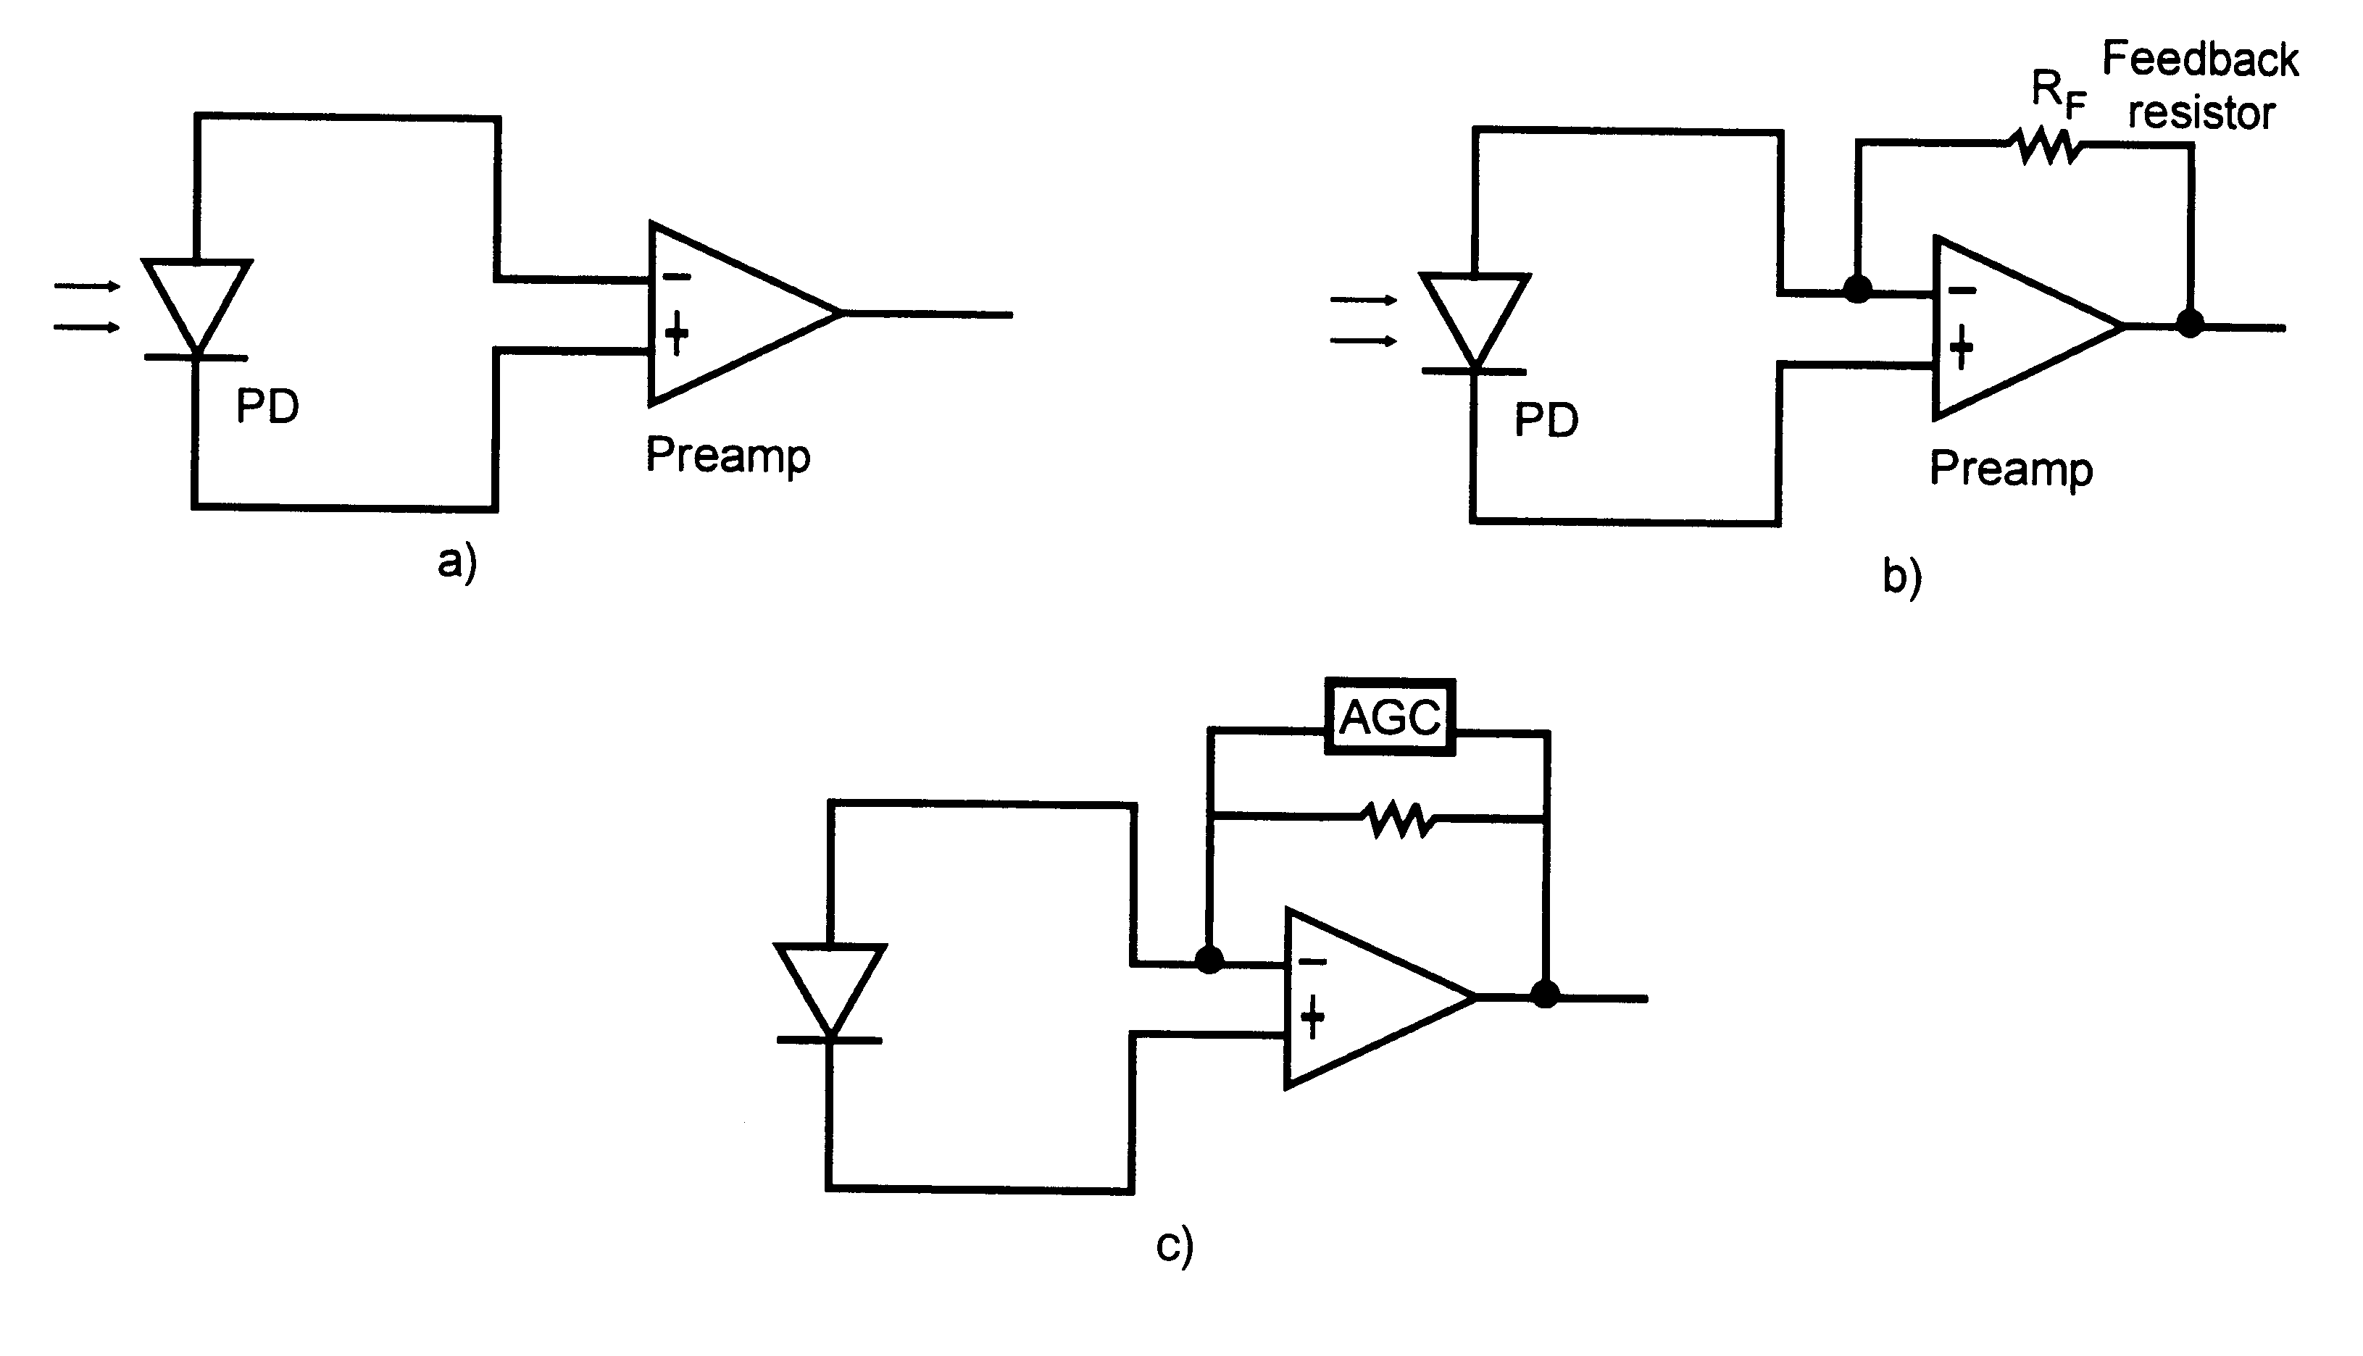
Equivalent Circuits of an Optical Receiver
High Impedance Design
Transimpedance Design
Transimpedance with Automatic Gain Control
Fiber-Optic Communications Technology-Mynbaev & Scheiner

Slide 5
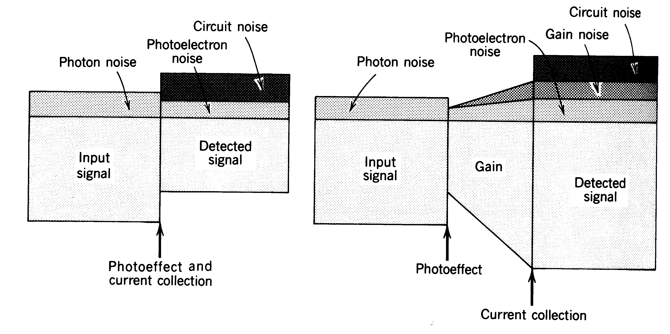
Receiver Noise Sources
Photon Noise
  Also called shot noise or Quantum noise, described by poisson statistics
Photoelectron Noise
  Randomness of photodetection process leads to noise
Gain Noise
  eg. gain process in APDs or EDFAs is noisy
Receiver Circuit noise
  Resistors and transistors in the the electrical amplifier contribute to circuit noise
Photodetector without gain
Photodetector with gain (APD)

Slide 6
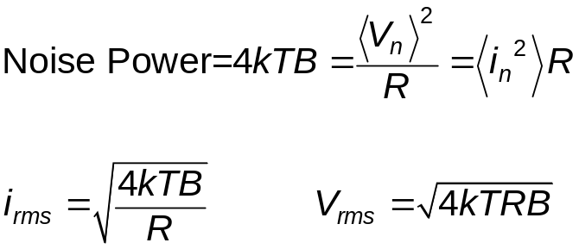

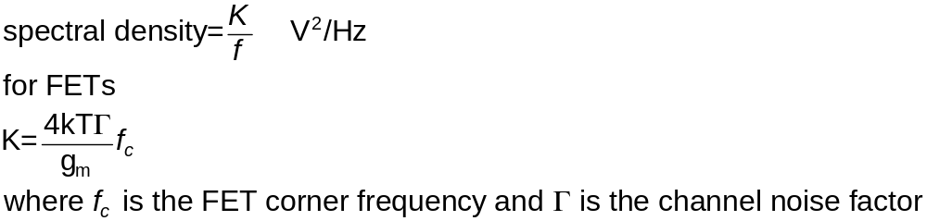
Noise
Johnson noise (Gaussian and white)
Noise Power
Frequency
Shot noise (Gaussian and white)
Noise Power
Frequency
“1/f” noise
1/f noise
Noise Power
F_{c}
Frequency

Slide 7
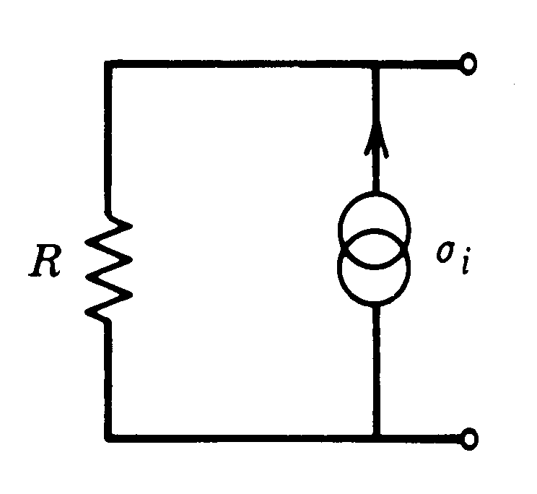
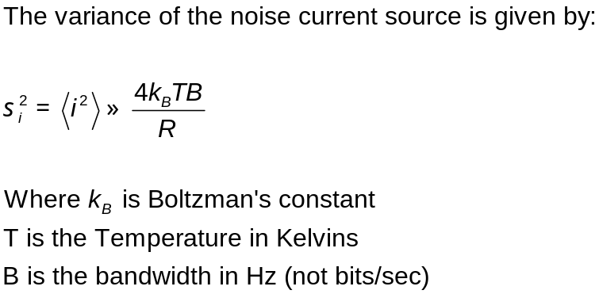
Johnson (thermal) Noise
Noise in a resistor can be modeled as due to a noiseless resistor in parallel with a noise current source

Slide 8
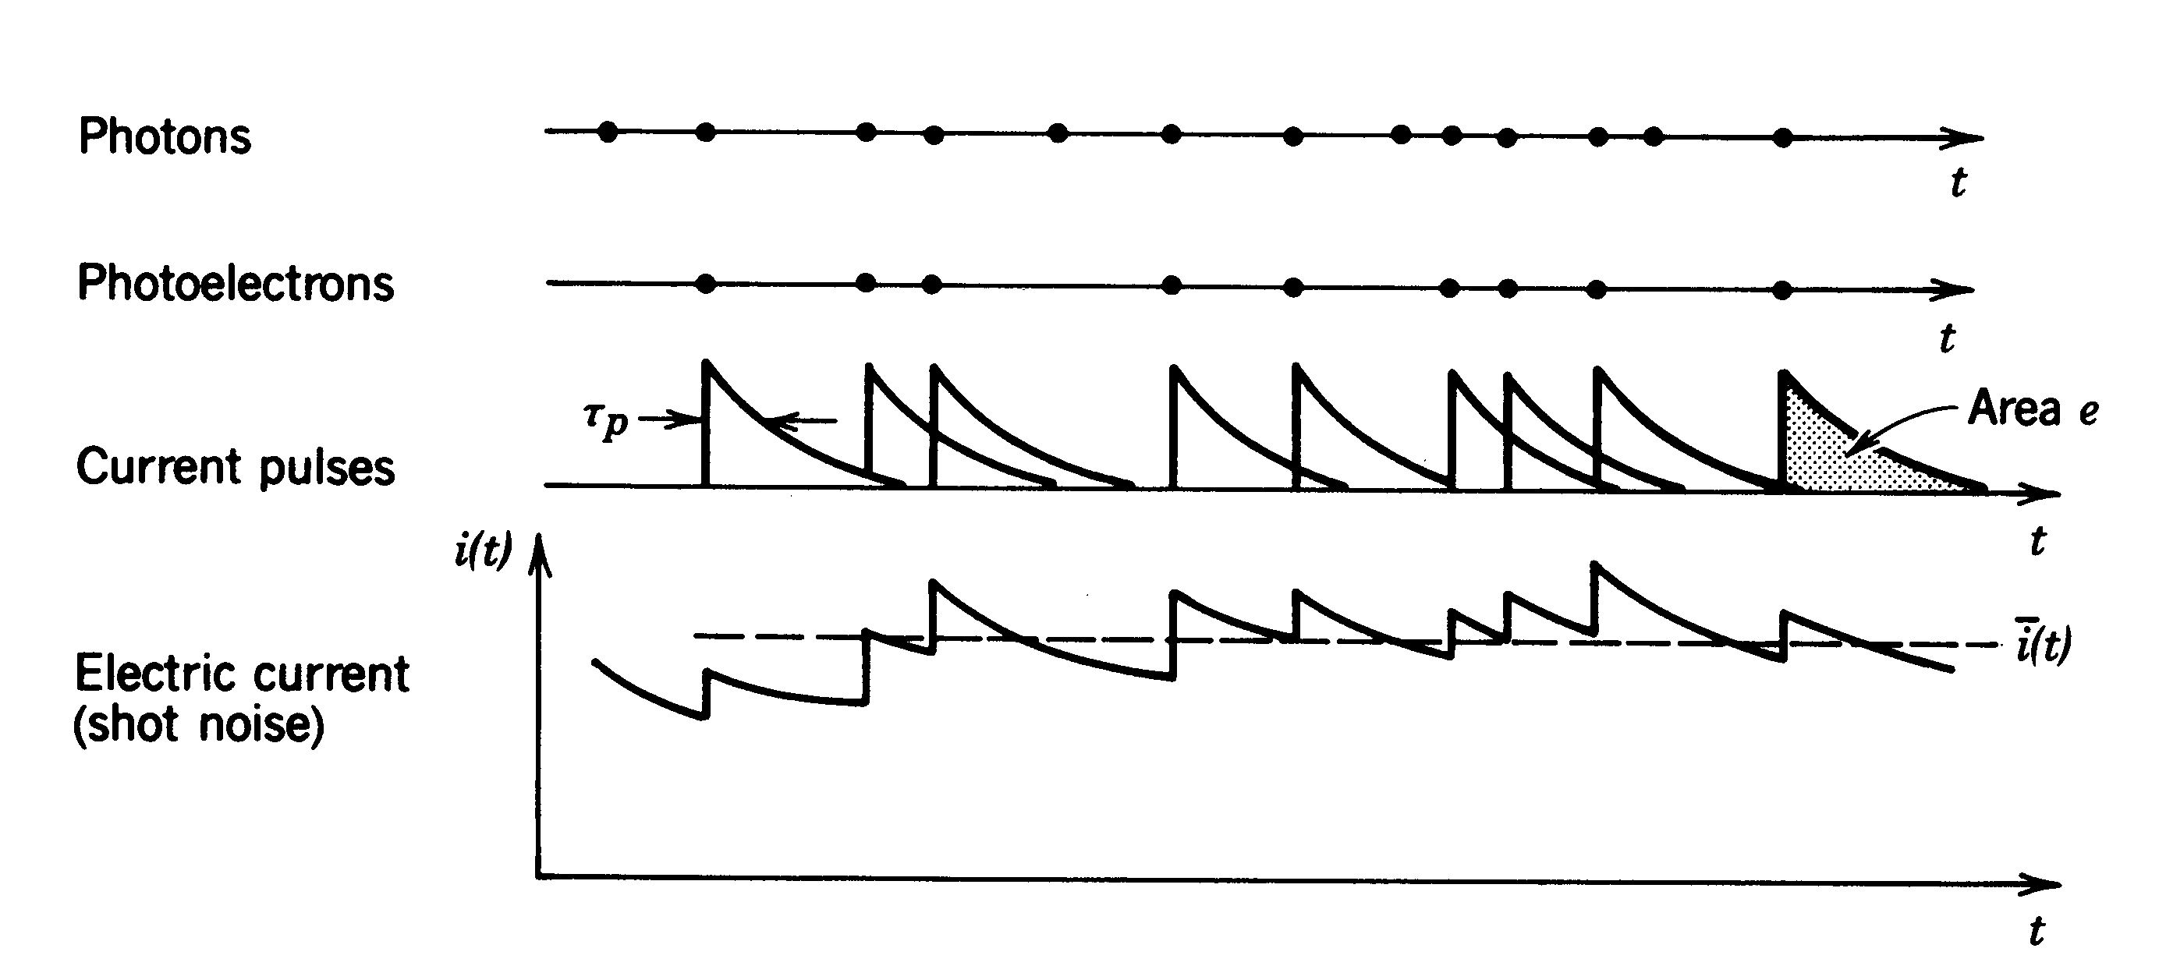
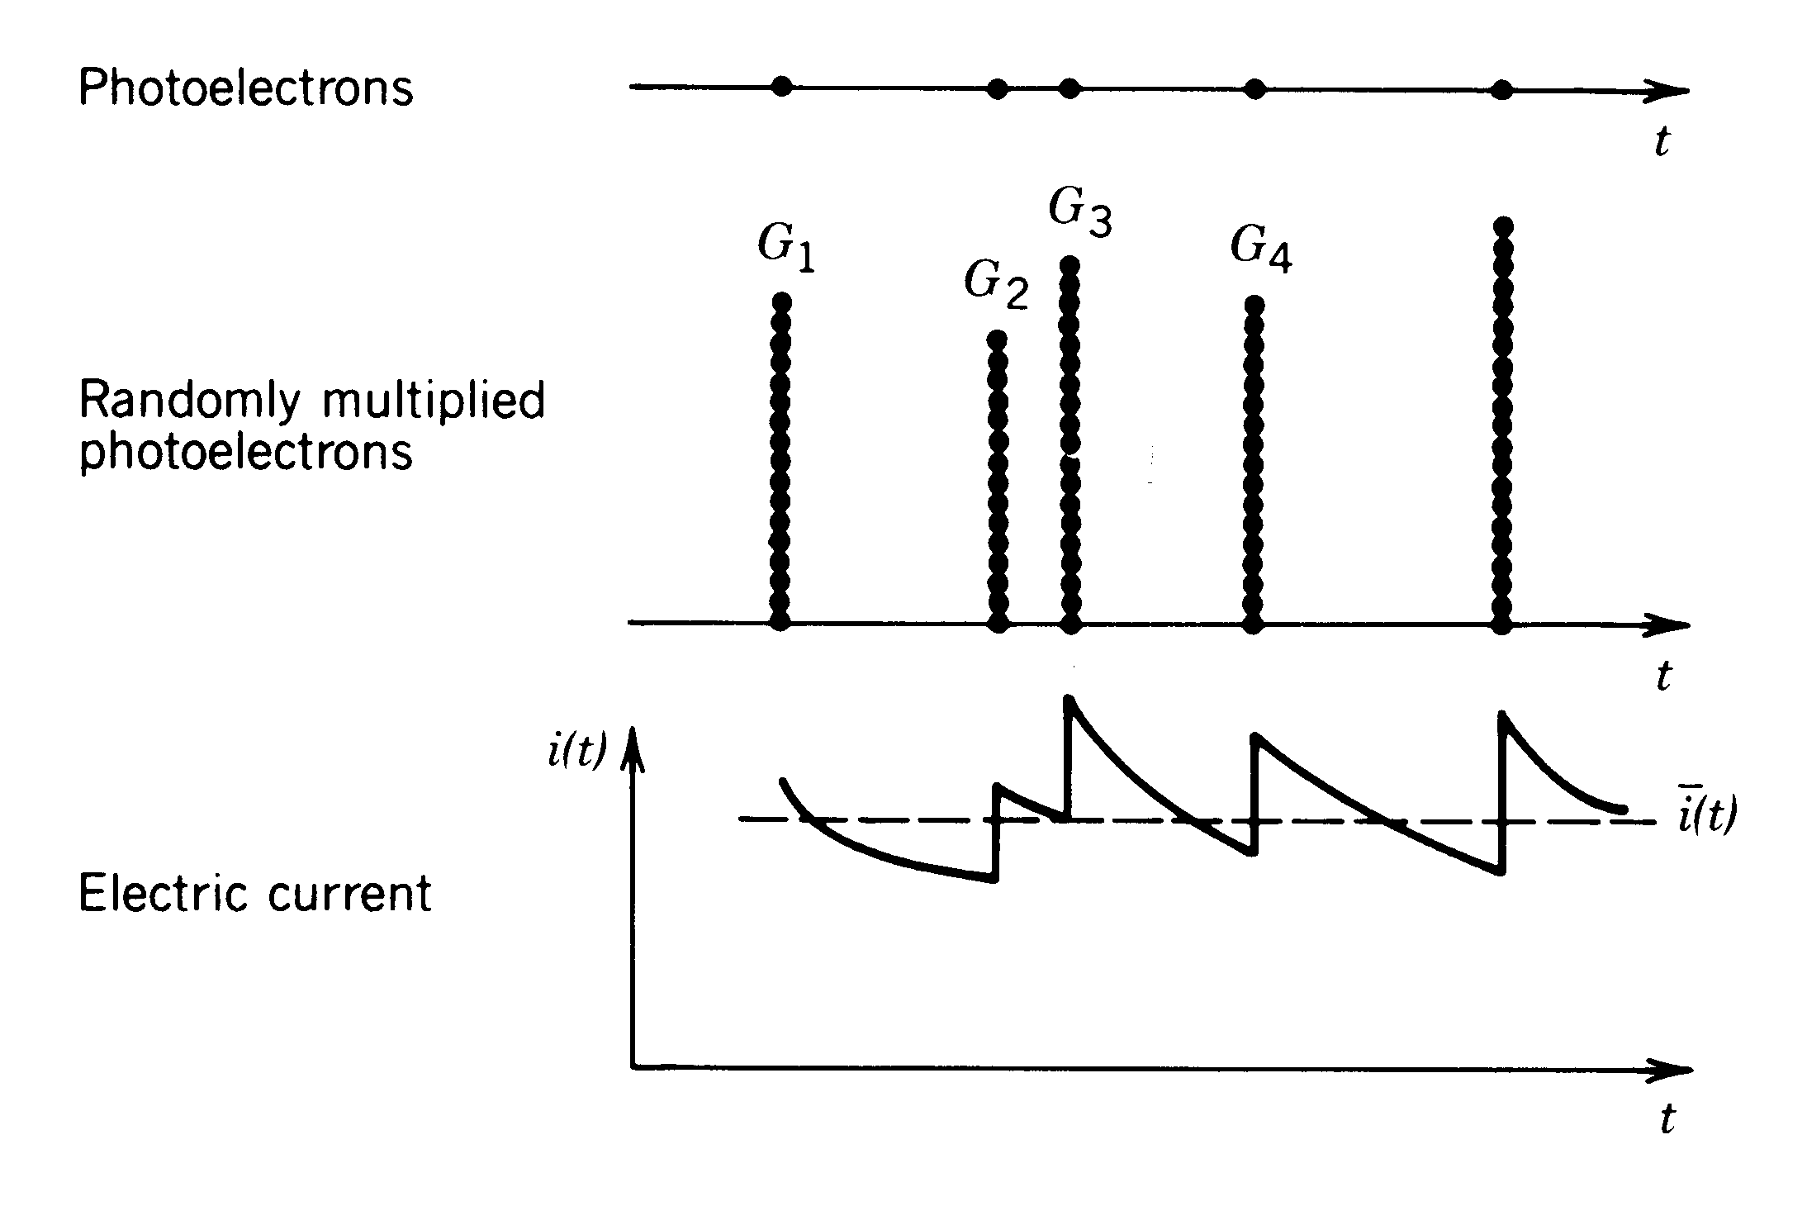
Photodetection noise
The electric current in a photodetector circuit is composed of a superposition of the electrical pulses associated with each photoelectron
The variation of this current is called shot noise
Noise in photodetector
If the photoelectrons are multiplied by a gain mechanism then variations in the gain mechanism give rise to an additional variation in the current pulses. This variation provides an additional source of noise, gain noise
Noise in APD

Slide 9
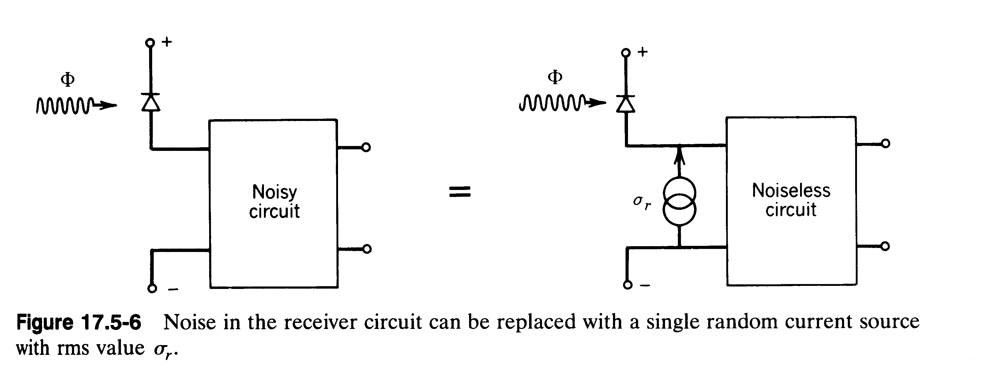
Circuit Noise

Slide 10
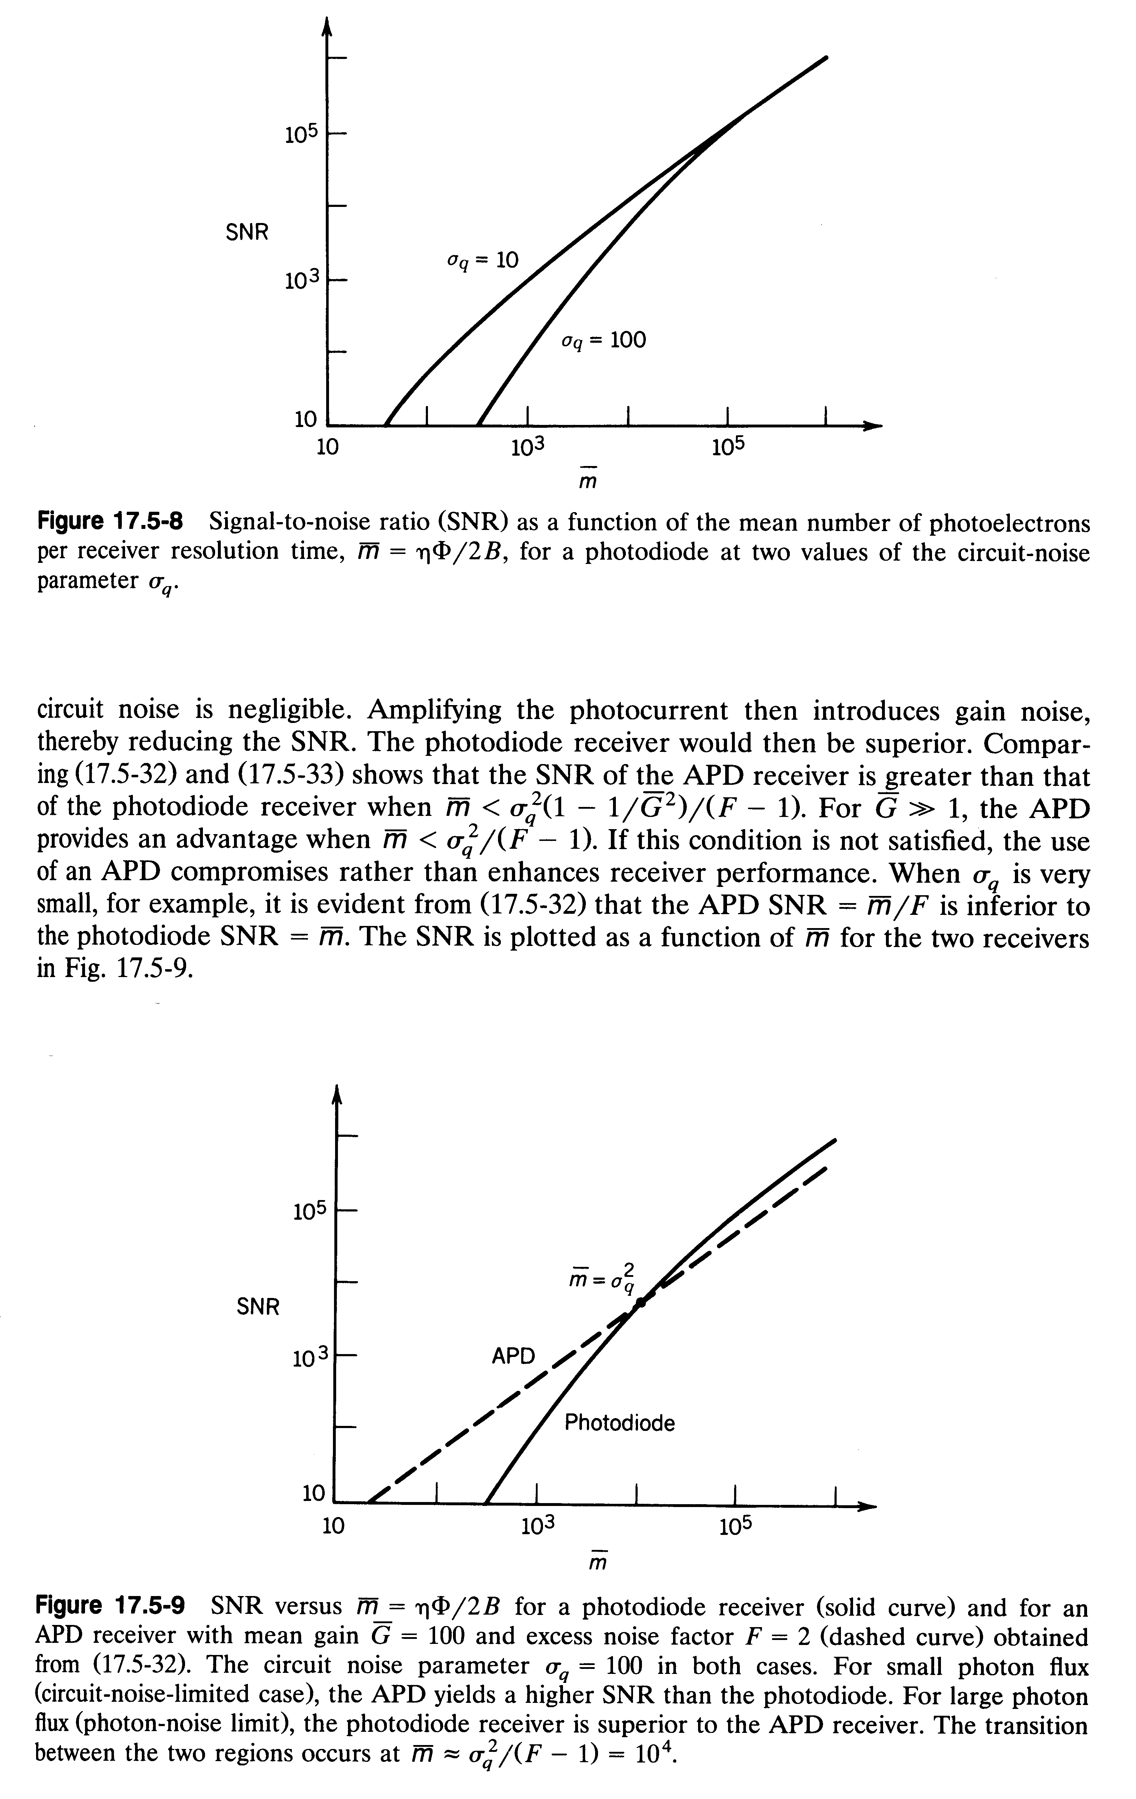
Signal to Noise Ratio
Signal to noise Ratio (SNR) as a function of the average number of photo electrons per receiver resolution time for a photo diode receiver at two different values of the circuit noise
Signal to noise Ratio (SNR) as a function of the average number of photoelectrons per receiver resolution time for a photo diode receiver and an APD receiver with mean gain G=100 and an excess noise factor F=2
At low photon fluxes the APD receiver has a better SNR. At high fluxes the photodiode receiver has lower noise

Slide 11
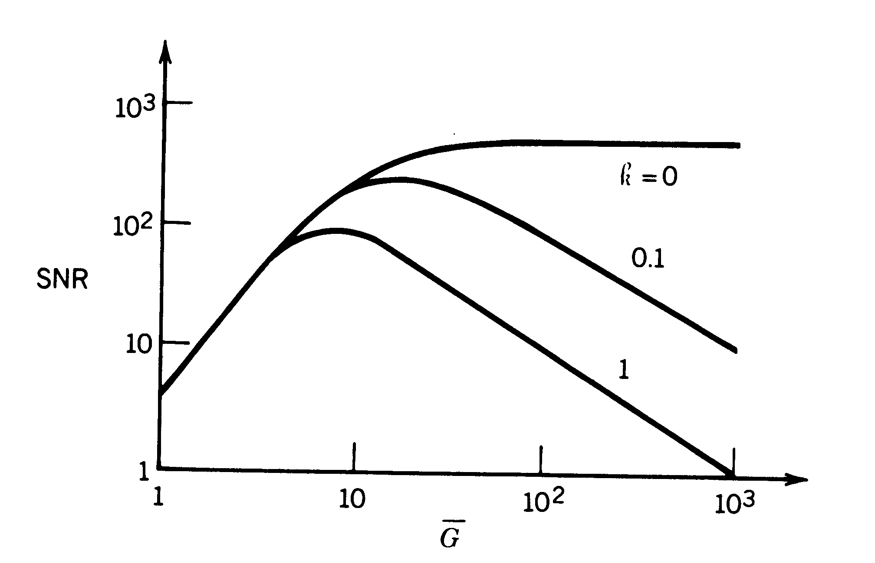
Dependence of SNR on APD Gain
Curves are parameterized by k, the ionization ratio between holes and electrons
Plotted for an average detected photon flux of 1000
and constant circuit noise

Slide 12
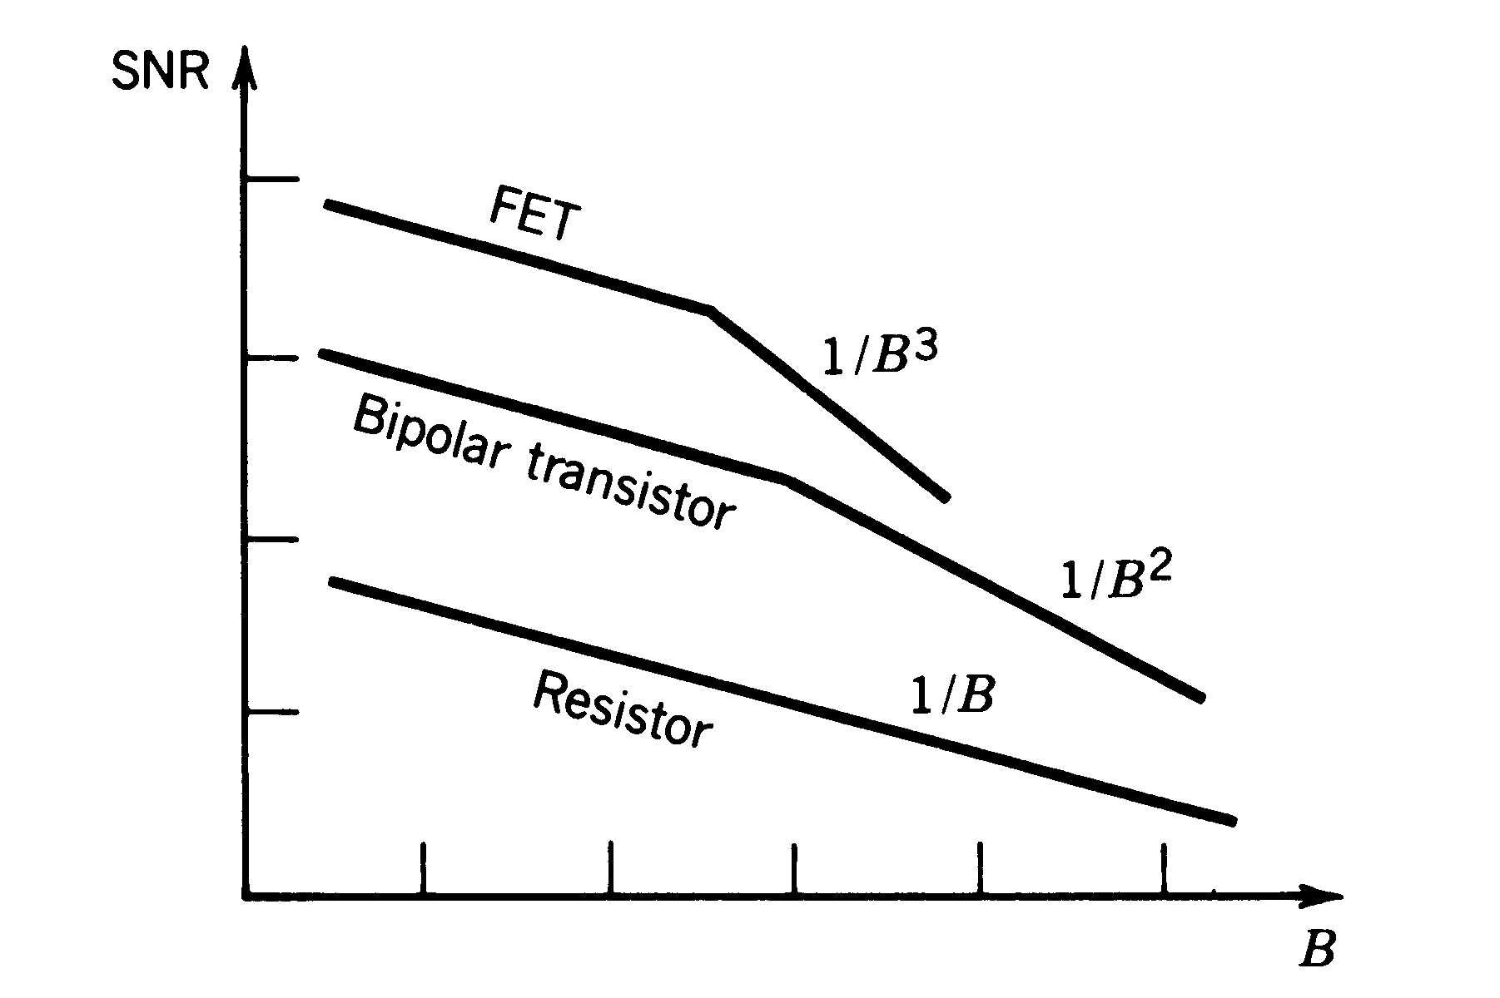
Receiver SNR vs Bandwidth
Double logarithmic plot showing the receiver bandwidth dependence of the SNR for a number of different amplifier types

Slide 13
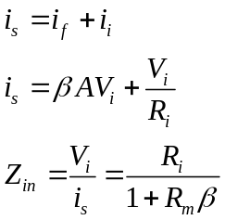

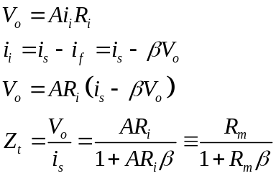
Basic Feedback Configuration
I_{s}
I_{i}
A V_{i}
+
R_{o}
I_{s}
I_{f}
R_{i}
-
Parallel Current Feedback
Lowers Input Impedance
Parallel Voltage Sense:
Voltage Measured and held
Constant
=> Low Output Impedance
βV_{o}
Stabilizes Transimpedance Gain
I_{i}
Z_{t}I_{i}
+
Z_{o}
Z_{i}
-

Slide 14
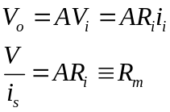
Transimpedance Amplifier Design
i
+
Output Voltage
Proportional to
Input current
Z i
-
Zero
Input
Impedance
V_{i}
A V_{i}
+
R_{o}
R_{i}
-
Typical amplifier model
With generalized input impedance
And Thevenin equivalent output
+
A V_{i}
+
R_{o}
i_{s}
V_{i}
R_{i}
V_{o}
-
-
Calculation of
Openloop transimpedance gain: R_{m}

Slide 15
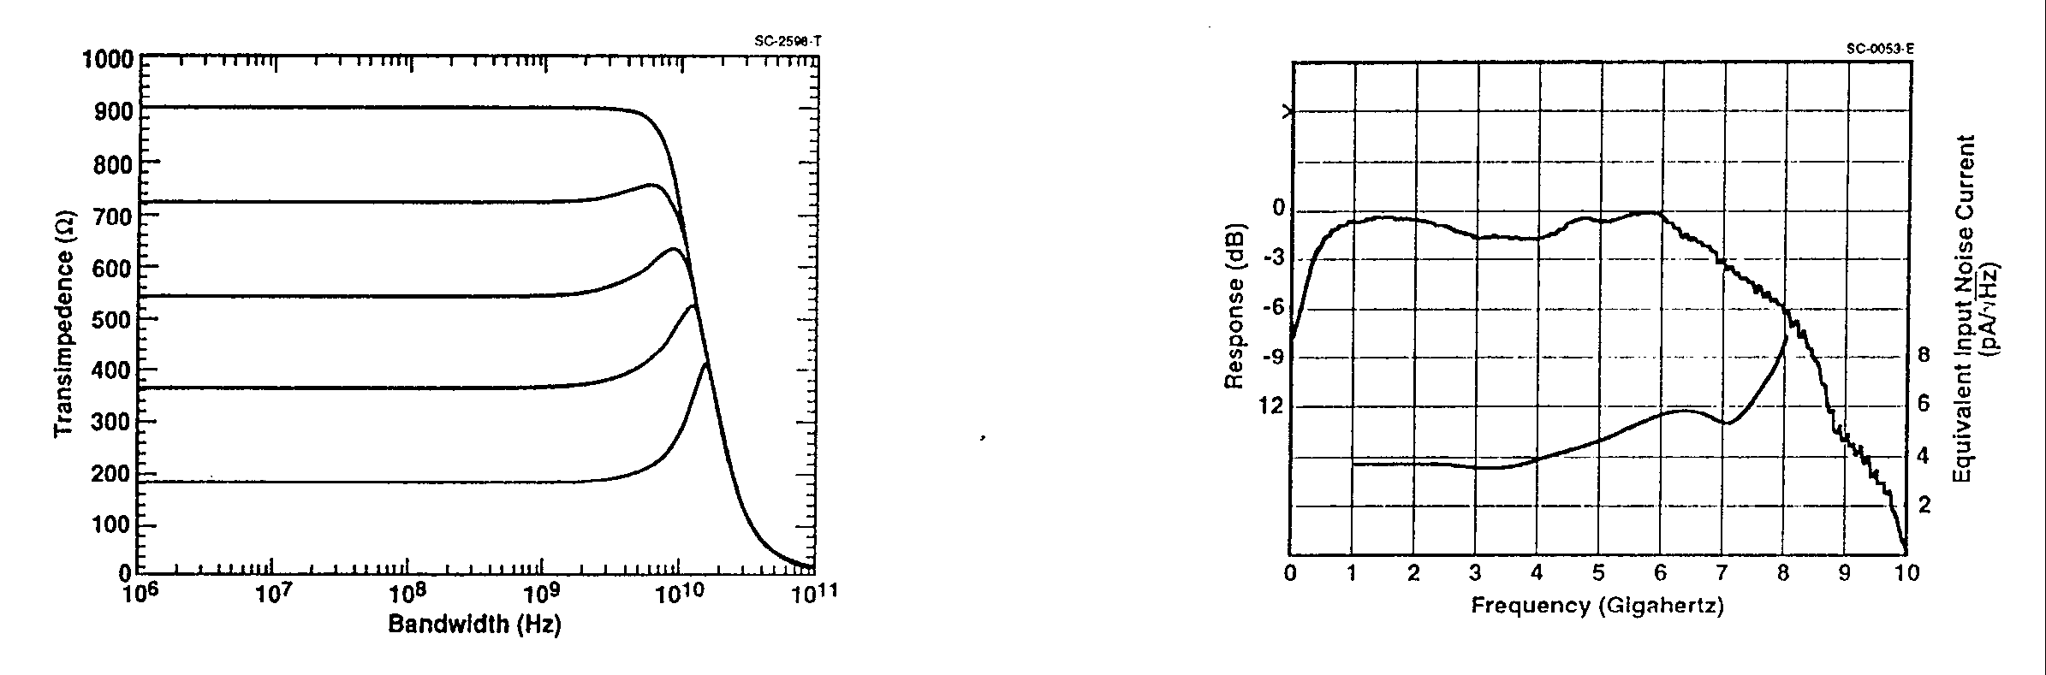
Transimpedance Amplifier Design Example
Vcc1
Vcc2
Controls open loop gain
of amplifier, Reduce to decrease
“peaking”
Rc
See Das et. al. Journal of Lightwave Technology
Vol. 13, No. 9, Sept.. 1995
For an analytic treatment of the design of maximally flat
high sensitivity transimpedance amplifiers
Q2
Q1
Out
Photodiode
Rf
Most Common Topology
Has good bandwidth
and dynamic Range
Vbias
Transimpedance approximately equals Rf
low values increase peaking and bandwidth

Slide 16
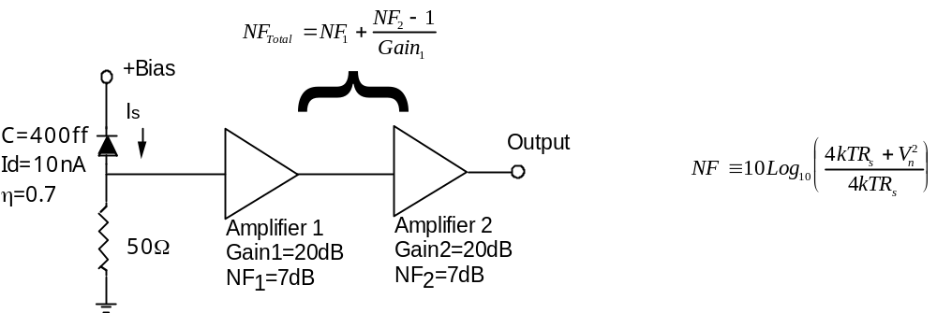
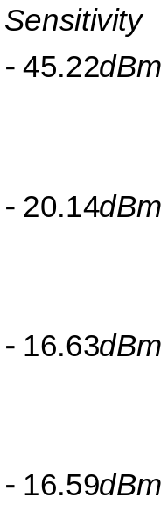

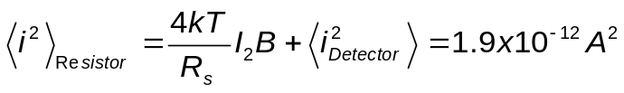
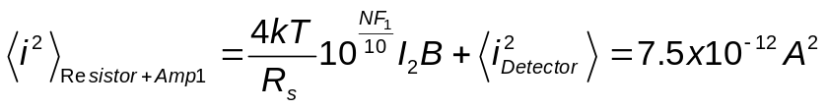
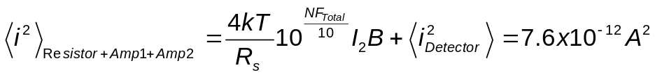
“Off-the-shelf” Receiver Example

Slide 17
Bit Error Rate
BER is equal to number of errors divided by total number of pulses (ones and zeros). Total number of pulses is bit rate B times time interval. BER is thus not really a rate, but a unitless probability.

Slide 18
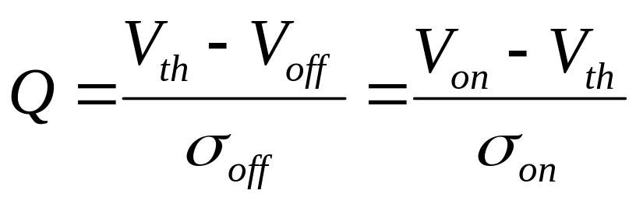
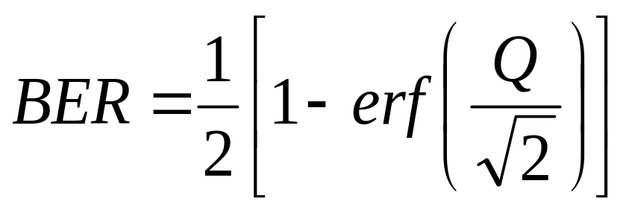
Q Factor and BER

Slide 19
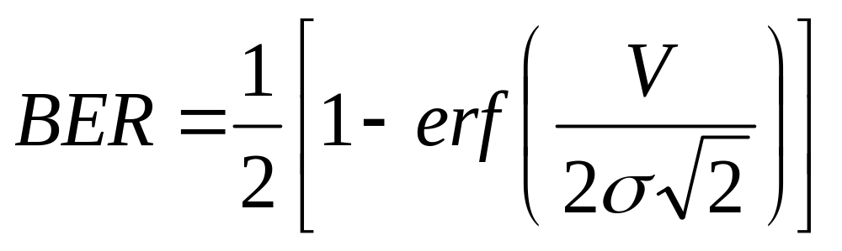
BER vs. Q, continued
When σ_{off =} σ_{on} and V_{off}=0 so that V_{th}=V/2, then Q=V/2σ. In this case,

Slide 20
Sensitivity
The minimum optical power that still gives a bit error rate of 10⁻⁹ or below

Slide 21
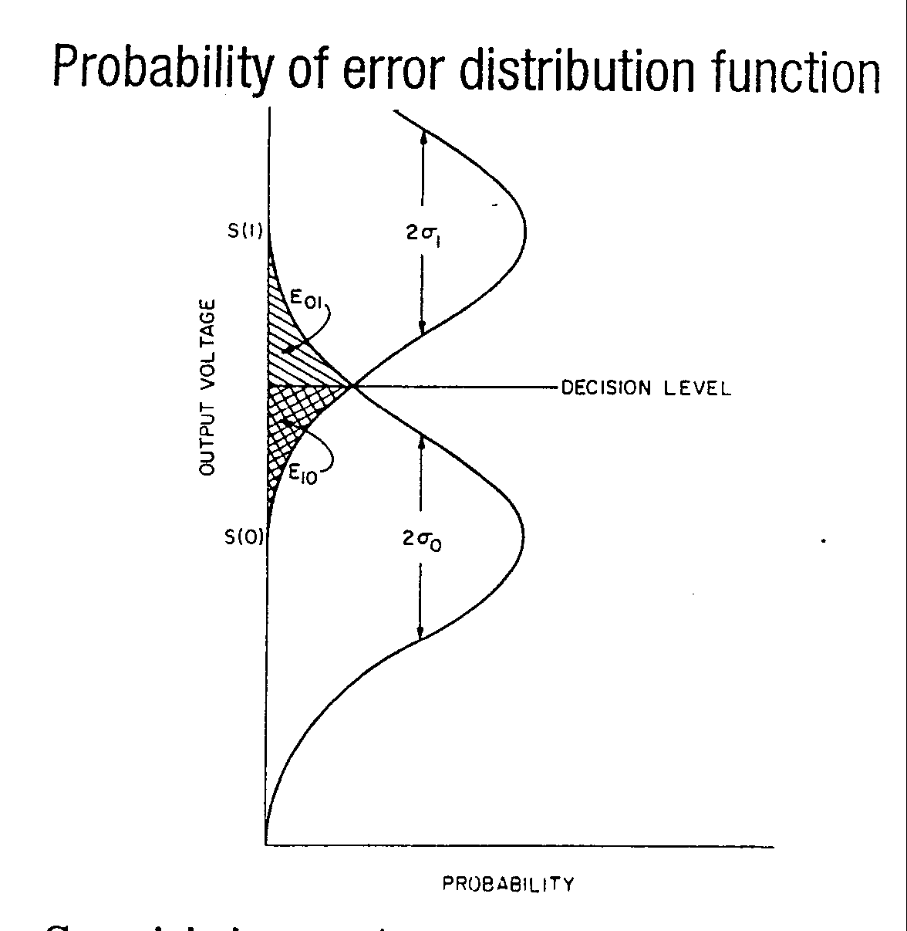
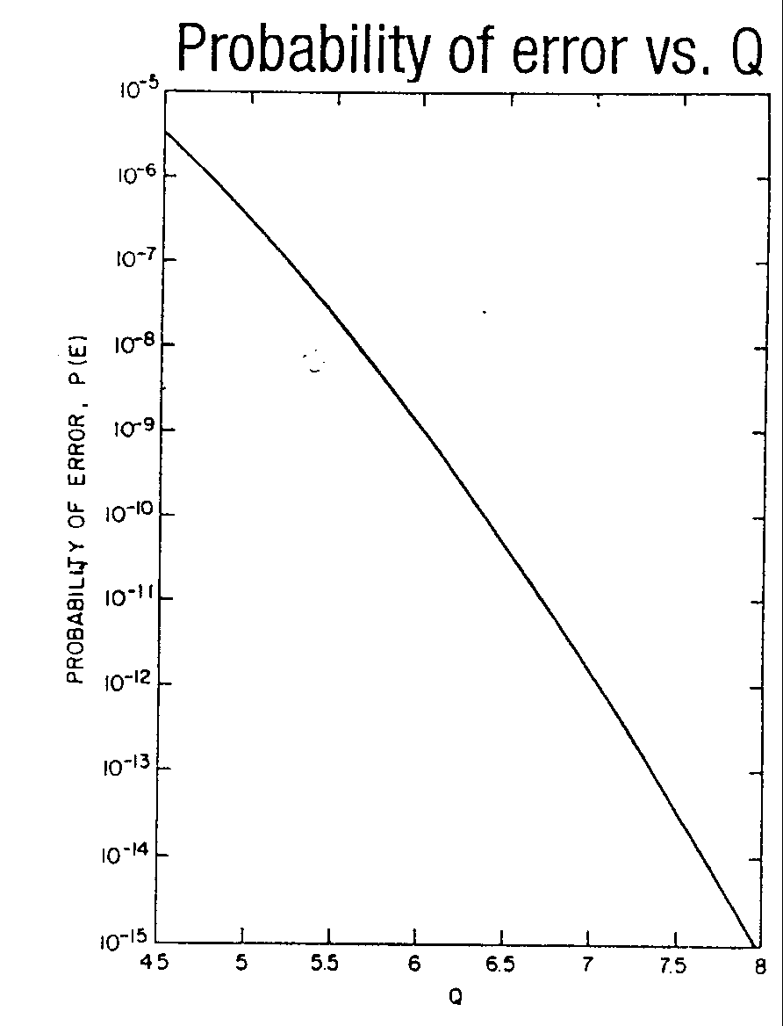
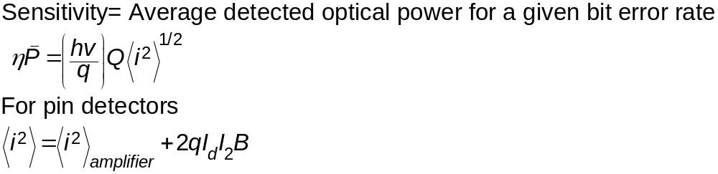
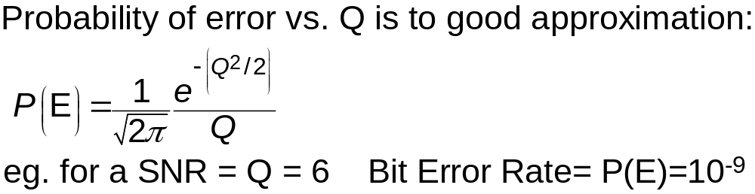
Receiver Sensitivity
(Smith and Personick 1982)

Slide 22
Dynamic Range and Sensitivity Measurement
Dynamic range is the Optical power difference in dB over which the BER remains
within specified limits (Typically 10-9/sec)
The low power limit is determined by the preamplifier sensitivity
The high power limit is determined by the non-linearity and gain compression
Maximum Signal Level
Input
Optical
Power
Dynamic Range
receiver Sensitivity
High Rf
(High Impedance Preamplifier)
Feedback Resistance
Low Rf
(Transimpedance Preamplifier
Patten
Generator
Transmitter
Adjustable
Attenuator
Optical
Receiver
Bit Error
Rate Counter
Optional Clock
Experimental Setup

Slide 23
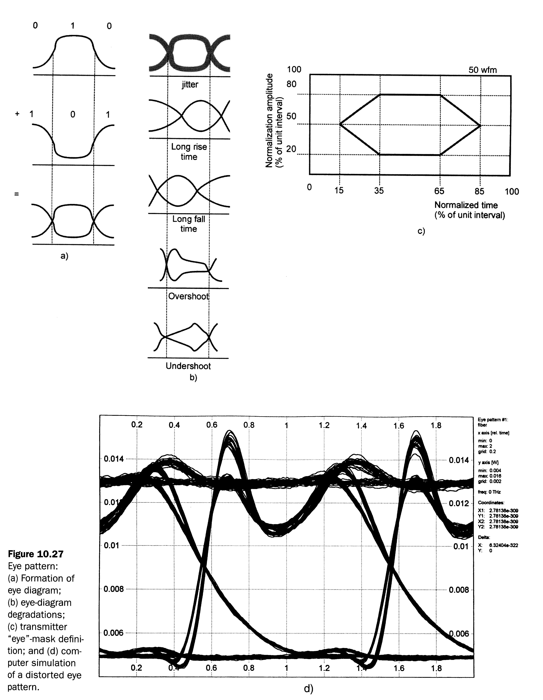
Eye Diagrams
Transmitter
“eye” mask
determination
Formation of eye diagram
Eye diagram
degradations
Computer Simulation of a distorted eye diagram
Fiber-Optic Communications Technology-Mynbaev & Scheiner

Slide 24
Power Penalties
Extinction ratio
Intensity noise
Timing jitter

Slide 25
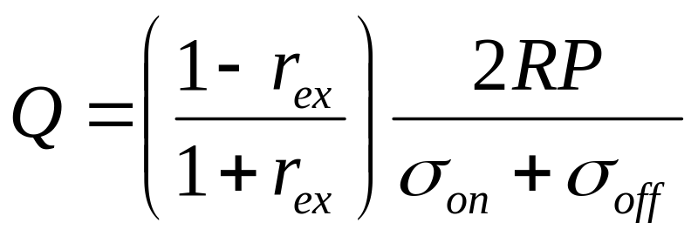
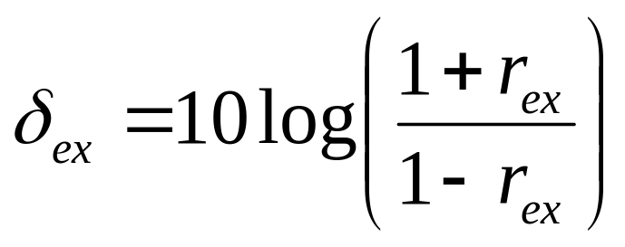
Extinction ratio penalty
Extinction ratio r_{ex}=P₀/P₁

Slide 26
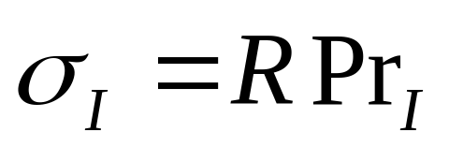
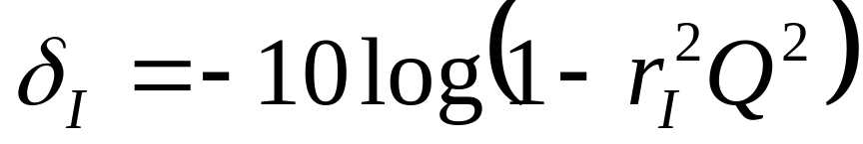
Intensity noise penalty
r_{I}=inverse of SNR of transmitted light

Slide 27
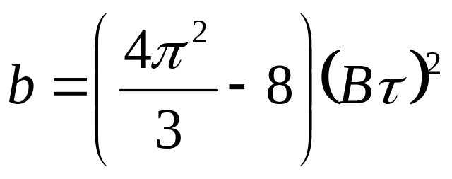
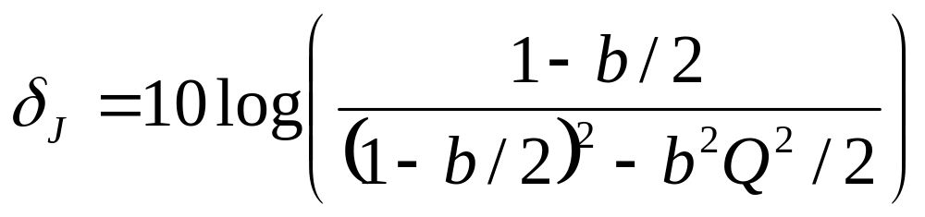
Timing jitter penalty
Parameter Bτ=fraction of bit period over which apparent clock time varies

Slide 28
Optical Measurements
Introduction
Early fiber optic systems need only modest test.
Now the industry is evolving, thus optical fibre systems and measurement technology need to be improved.
Narrow wavelength spacing:
  WDM systems with 100 GHz
  E.g. power, signal-to-noise ratio, wavelength
High data rates:
  > 10 Gb/s requires compatible components characteristic
  E.g. spectrum width, dispersion, bandwidth response
Optical amplifier:
  Enabling WDM systems
  E.g. gain, noise figure
Question
  Why need accurate and reliable optical test & measurement techniques?

Slide 29
Optical Measurements
Introduction
Expansion of optical communication systems
  Replacing copper cables everywhere, towards access area
Complex fibre optic systems
  All optical networks – passive and active
Self-review of the basic features of a fiber-optic communication link are necessary.
Fibre optic link measurements determine if the system meets its end design goals.
All of the components contained within the link must be characterized and specified to guarantee system performance.
Question
  What are the things to know before proceeding with fiber optic test & measurement?

Slide 30
Optical Measurements
Introduction
Optical fibres:
  Singlemode fibres – Standard fibre, Dispersion-shifted fibre, Non-zero Dispersion-shifted fibre, Polarization Maintaining fibre, Erbium-doped fibre
  Multimode fibres – Step index, Graded-Index
Optical components:
  Two-port optical components: have optical input and optical output. E.g. WDM coupler, Bandpass filter, Isolator
  Single-port components. E.g. Transmitter, Receiver
This chapter will briefly introduce the types of measurements that can be made to the fibre optic and optical components.
The details of each measurement will be discussed in the dedicated chapters.
Question
  What are the parameters to measure?

Slide 31
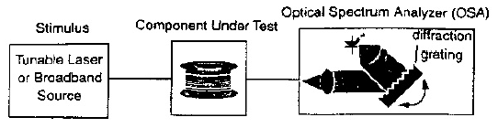
Measurement of Optical Fibre and Two-port Components
Insertion Loss
Both a source and receiver are necessary
Source – a wavelength tunable laser or a broadband source
Receiver – an optical power meter (OPM) or an optical spectrum analyzer (OSA)
The figure below shows a typical measurement set-up for an insertion loss measurement.
Question
  What are the principal differences between the two sources?

Slide 32
Measurement of Optical Fibre and Two-port Components
Insertion Loss
Optical power meter
  Calibrated optical to electrical converter
  No wavelength information
Optical spectrum analyzer
  Tunable bandpass filter + power meter
Questions
  Does an optical spectrum analyzer provide wavelength information and why?
  How to use an OPM but still getting the wavelength information?

Slide 33
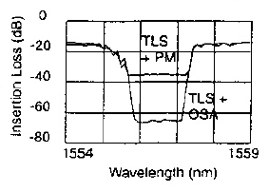
Measurement of Optical Fibre and Two-port Components
Insertion Loss
TLS + OPM
  Large measurement range, but < 200nm
  Fine wavelength resolution
  Major limitation – broadband noise from TLS
Questions
  What is the noise referring to?
  How to improve the measurement using the TLS?

Slide 34
Measurement of Optical Fibre and Two-port Components
Insertion Loss
TLS + OSA
  Highest performance solution
  TLS provides narrow spectral width
  OSA provides additional filtering of the broadband noise emission
Questions
  What is the direct effect on the measured spectrum by using the above configuration?

Slide 35
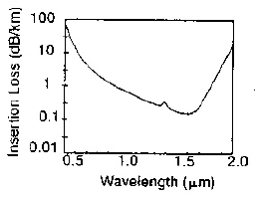
Measurement of Optical Fibre and Two-port Components
Insertion Loss
Broadband emission source + OSA
  Wide wavelength range coverage
  Moderate measurement range
  Fast measurement speed
  Tungsten lamp emitters – entire fibre-optic communication wavelength range
  Optical amplifiers – narrower wavelength ranges, but with much higher power
Question
  What is the disadvantage of a tungsten lamp source?

Slide 36
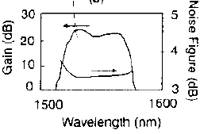
Measurement of Optical Fibre and Two-port Components
Amplifier Gain and Noise Figure
Gain measurements
  Often done in large signal conditions – gain saturation
  Requires a high-power excitation source
Characterization of noise
  Optical domain – measure the level of ASE coming from the amplifier
  Electrical domain – use a photodetector and an electrical spectrum analyser to characterize the total amount of detected noise produced by the system
Question
  What is the potential error in the measurement of the amplifier noise?

Slide 37
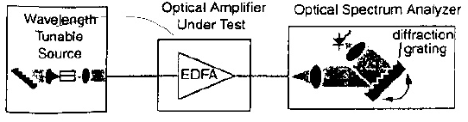
Measurement of Optical Fibre and Two-port Components
Amplifier Gain and Noise Figure
The figure below shows a test configuration used to measure gain and noise figure of optical amplifier
For WDM systems – characterization needs the same signal-loading conditions as in the actual application
Question
  Why is there a difference in the optical amplifier characterization between single- and multi-channel systems?

Slide 38
Measurement of Optical Fibre and Two-port Components
Chromatic Dispersion
Measurement is accomplished by analyzing the group delay through the fiber/components as function of wavelength
Procedure
  A wavelength tunable optical source is intensity modulated
  The phase of the detected modulation signal is compared to that of the transmitted modulation
  The wavelength of the tunable source is then incremented and the phase comparison is made again
  The phase delay is converted into the group delay
Question
  What is the waveform shape of the modulation signal?

Slide 39
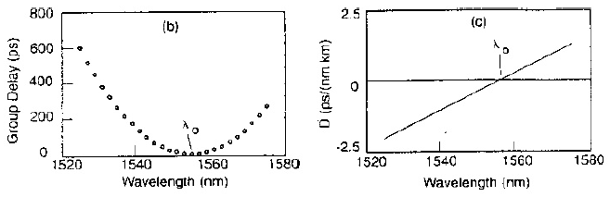
Measurement of Optical Fibre and Two-port Components
Chromatic Dispersion
The figure shows the result for the measurement of the group delay with wavelength
Question
  How can the group delay be calculated from the phase delay?

Slide 40
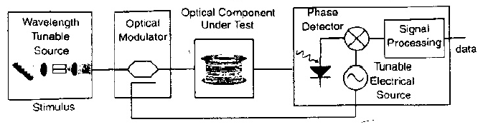
Measurement of Optical Fibre and Two-port Components
Chromatic Dispersion
The figure shows the chromatic dispersion measurement set-up for two-port optical devices
Accurate characterization of the minimum fibre dispersion wavelength is important in the design of high-speed TDM and WDM communication systems
Dispersion compensation components also require accurate measurement of dispersion
Question
  Why is it important to characterize chromatic dispersion of fibre?

Slide 41
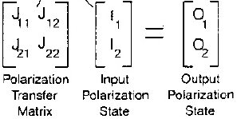
Measurement of Optical Fibre and Two-port Components
Polarization
Polarization of the lightwave signal refers to the orientation of the electric field in space
E.g. insertion loss and group delay of a two-port optical component vary as a function of the input polarization
Polarization transfer function characterization
  Polarization analyzer measures the polarization state
  The polarization state is represented by a Jones polarization-state vector
  Jones state vector contains two complex numbers that quantify the amplitude and phase of the vertical and horizontal components of the optical field
Question
  How does the polarization state of a linearly polarized light evolve in a fibre?

Slide 42
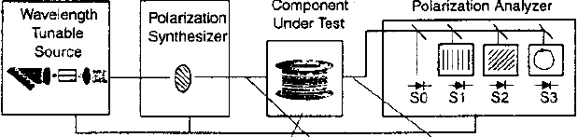
Measurement of Optical Fibre and Two-port Components
Polarization
The Jones matrix measurement
  Apply three well-known polarization states at the input
  Characterize the resulting output polarization state in the polarization analyzer
The Jones matrix of the polarization transfer function will predict the output polarization state for any input polarization state
The figure below illustrates a measurement technique to characterize the polarization transfer function of optical fibre and components.

Slide 43
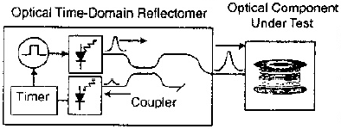
Measurement of Optical Fibre and Two-port Components
Reflection
Optical time-domain reflectometry (OTDR) can measure reflection from the surfaces of components or fibres (thus fibre breaks)
The figure shows an OTDR measurement block diagram
OTDR injects a pulsed signal onto the fibre optic cable
A small amount of the pulsed signal is continuously reflected back in the opposite direction by the irregularities in the optical fibre structure – Raleigh backscatter
Question
  Why is a pulsed signal necessary?

Slide 44
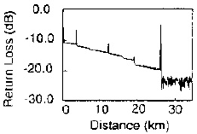
Measurement of Optical Fibre and Two-port Components
Reflection
The figure shows an example OTDR display
The locations and magnitudes of faults
  Determined by measuring the arrival time of the returning light
  Reduction in Raleigh scattering and occurrence of Fresnel reflection
Question
  How to determine the locations and magnitudes of faults?

Slide 45

Measurement of Transmitter and Receiver
Power
The figure illustrates a basic power-meter instrument diagram
Process
  Source – optical fibre – photodetector – electrical current
Responsivity
  The conversion efficiency between the input power and the output current
  Units of Amps/Watt
  A function of wavelength for all photodetectors
  Must be calibrated in order to make optical power measurements

Slide 46
Measurement of Transmitter and Receiver
Power
Thermal-detector heads
  Measure the temperature rise caused by optical signal absorption
  Very accurate and are wavelength-independent
  Suffer from poor sensitivity
Thermal detectors are used to calibrate photodetectors
Upper power limit
  Determined by saturation effects
  Responsivity decreases beyond this point
Lower power limit
  Limited by the averaging time of the measurement and the dark current
Design considerations
  Power meters have to be independent of the input polarization
  The reflectivity of the optical head has to be eliminated

Slide 47
Measurement of Transmitter and Receiver
Polarization
Light sources
  Laser sources are predominantly linear polarized sources
  LEDs have no preferred direction of polarization and are predominantly unpolarized
Polarization effects
  Polarization-dependent loss, gain, or velocity
  These are influenced by the ambient conditions, e.g. stress, temperature
  Thus, a polarized input will perform unpredictably
Polarization measurement
  To determine the fraction of the total light power that is polarized
  To determine the orientation of the polarized component
Question
  Gives the names for the polarization effects?

Slide 48

Measurement of Transmitter and Receiver
Polarization
The figure illustrates a polarization analyzer instrument
Polarization analyzer
  Four power meters with polarization characterizing optical components
  It measures the Stokes parameters: S₀, S₁, S₂, S₃
    S₀ – total power of the signal
    S₁ – power difference between vertical and horizontal polarization components
    S₂ – power difference between +45 and -45 degrees linear polarization
    S₃ – power difference between right-hand and left-hand circular polarization
  S₁ and S₂ are measured with polarizers in front of detectors
  S₃ is measured with a waveplate in front of a detector

Slide 49

Measurement of Transmitter and Receiver
Polarization
The polarization state of a source is conveniently visualized using a Poincaré sphere
Poincaré sphere
  The axes are the Stokes parameters normalized to S₀ – values are between 0 and 1
  Polarization state is represented by the three-dimensional coordinates (S₁, S₂, S₃)
Questions
  What is the state the outer surface of the sphere represents?
  What is the polarization state along the equator?
  What is the polarization state between the equator and the poles?

Slide 50
Measurement of Transmitter and Receiver
Polarization
The degree of polarization (DOP) is used to indicate the extent of polarization in a source.
DOP
  100% is found on the outer surface
  0% is found in the centre
The polarization of an optical signal is constantly changing, thus all optical components should be polarization independent
Questions
  Why does the polarization of an optical signal constantly changing?
  What is the benefit of having polarization-independent components?

Slide 51


Measurement of Transmitter and Receiver
Optical Spectrum Analysis
An optical spectrum analyzer (OSA) is used to measure the power versus wavelength
The figure shows an OSA that uses a diffraction grating
Question
  What is a diffraction grating?

Slide 52
Measurement of Transmitter and Receiver
Optical Spectrum Analysis
OSA
  Consists of a tunable bandpass filter and an optical power meter
  The light from the input fibre is collimated and applied to the diffraction grating
  The diffraction grating separates the input light into different angles depending on wavelength
  The light from the grating is then focused onto an output slit
  The grating is rotated to select the wavelength that reaches the optical detector
Question
  What are the components in the OSA that constitute to the tunable bandpass filter?

Slide 53
Measurement of Transmitter and Receiver
Optical Spectrum Analysis
The filter bandwidth is determined by
  the diameter of the optical beam that is incident on the diffraction grating
  the aperture size at the input and output of the optical system
Fabry-Perot (FP) filters
  Can also be used as the bandpass filter
  Offer the possibility of very narrow wavelength resolution
  The disadvantage is that these filters have multiple passbands
Question
  What are the consequence of having a bandpass filter with multiple passbands in an OSA?

Slide 54

Measurement of Transmitter and Receiver
Optical Spectrum Analysis
The figure below shows a spectral plot for a DFB laser that is modulated with 2.5 Gb/s digital data
Accurate spectral measurement
  The OSA must have a very narrow passband and steep skirts
  A filter stopband should be ≥ 50 dB down to measure the smaller sidelobes.
OSAs do not have sufficient resolution to look at the detailed structure of a laser longitudinal mode
Question
  What determines the value of the stopband?

Slide 55

Measurement of Transmitter and Receiver
Accurate Wavelength Measurement
The figure below illustrates a method by which very accurate wavelength measurements can be made
Michelson interferometer configuration
  The light from the unknown source is split into two paths
  Both are then recombined at a photodetector
  One of the path lengths is variable and the other is fixed in length

Slide 56

Measurement of Transmitter and Receiver
Accurate Wavelength Measurement
As the variable arm is moved, the photodetector current varies
To accurately measure the wavelength of the unknown signal, a reference laser with a known wavelength is introduced into the interferometer
Question
  Why does the photodetector current vary?

Slide 57
Measurement of Transmitter and Receiver
Accurate Wavelength Measurement
The wavelength meter compares the interference pattern from both lasers to determine the wavelength
This procedure makes the measurement method less sensitive to environmental changes
Reference lasers
  Helium-neon (HeNe) lasers emitting at 632.9907 nm are often used as wavelength references
  HeNe lasers have a well-known wavelength that is relatively insensitive to temperature
Wavelength meters have limited dynamic range compared to grating-based OSAs
Question
  Why does the use of reference laser make the wavelength meter less sensitive to environmental changes?

Slide 58

Measurement of Transmitter and Receiver
Linewidth and Chirp Measurement
Heterodyne and homodyne analysis tools are used to examine the fine structure of optical signals
These analysis methods allow the measurement of modulated and unmodulated spectral shapes of the longitudinal modes in laser transmitter
Heterodyne
  The figure illustrates a heterodyne measurement setup
  The unknown signal is combined with a stable, narrow-linewidth local oscillator (LO) laser
  The LO signal is adjusted to be within 50 GHz of the unknown signal to be detected by conventional electronic instrumentation

Slide 59

Measurement of Transmitter and Receiver
Linewidth and Chirp Measurement
Heterodyne
  The LO must have the same polarization for best conversion efficiency
  The two signals mix in the photodetector to produce a difference frequency (IF signal) in the 0 to 50 GHz region
  The IF signal is analyzed with an electronic signal analyzer (e.g. a spectrum analyzer)
  The figure shows the measurement of a laser under sinusoidal modulation at 500 MHz
  The major limitation is the availability of very stable LO signals

Slide 60
Measurement of Transmitter and Receiver
Linewidth and Chirp Measurement
Homodyne
  Limited information on the optical spectrum
  Much easier to perform
  LO is a time-delayed version of itself (more than the inverse of the source spectral width (in Hz)) – phase independent
  The intermediate frequency is centred around 0 Hz
  Limitations
    Asymmetries of the optical spectrum can not be seen
    No information about the centre wavelength of a laser
Question
  Why is the intermediate frequency for the homodyne technique centred around 0 Hz?

Slide 61

Measurement of Transmitter and Receiver
Linewidth and Chirp Measurement
The figure shows a homodyne measurement of an unmodulated DFB laser
Question
  What is the measured linewidth of the DFB laser?

Slide 62

Measurement of Transmitter and Receiver
Modulation Analysis: Frequency Domain
This characterization methods display information as a function of the modulation frequency
The figure shows a diagram of a lightwave signal analyzer
It consists of a photodetector followed by a preamplifier and an electrical spectrum analyzer
The modulation frequency response of these components must be accurately calibrated as a unit
This modulation domain signal analyzer measures the following modulation characteristics:
  Depth of optical modulation
  Intensity noise
  Distortion

Slide 63

Measurement of Transmitter and Receiver
Modulation Analysis: Frequency Domain
The figure shows the power of the modulation signal as a function of the modulation frequency – a DFB laser modulated at 6 GHz
The relative intensity noise (RIN) is characterized by ratioing the noise level at a particular modulation frequency to the average power of the signal
RIN measurements are normalize to a 1 Hz bandwidth
A DFB laser without modulation may have a RIN level of -145 dB/Hz

Slide 64

Measurement of Transmitter and Receiver
Modulation Analysis: Stimulus-Response Measurement
The figure shows the instrument for measuring the modulation response of optical receivers, transmitters and optical links
Electrical vector analyzer
  Its electrical source is connected to the optical transmitter
  An optical receiver is connected to the input
  Compares both the magnitude and phase of the electrical signals entering and leaving the analyzer

Slide 65

Measurement of Transmitter and Receiver
Modulation Analysis: Stimulus-Response Measurement
The figure shows measurements of a DFB laser transmitter and an optical receiver
Major challenges – calibration of the O/E and E/O converters in both magnitude and phase response

Slide 66

Measurement of Transmitter and Receiver
Modulation Analysis: Time Domain
The shape of the modulation waveform as it progress through a link is of great interest
An oscilloscope displays the optical power versus time, as shown in the figure below
High speed sampling oscilloscope
  Often used in both telecommunication and data communication systems
  Due to the gigabit per second data rates involved

Slide 67

Measurement of Transmitter and Receiver
Modulation Analysis: Time Domain
The figures below illustrate eye diagram measurement
Eye diagram
  The clock waveform is applied to the trigger of the oscilloscope
  The laser output is applied to the input of the oscilloscope through a calibrated optical receiver
  The display shows all of the digital transitions overlaid in time
  It can be used to troubleshoot links that have poor bit-error ratio performance

Slide 68

Measurement of Transmitter and Receiver
Modulation Analysis: Time Domain
International standards such as SONET (Synchronous Optical NETwork), and SDH (Synchronous Digital Hierarchy)
  Specify acceptable waveform distortion and time jitter
  Specify an optical receiver with a tightly controlled modulation response that is filtered at ¾ of the bit rate
The figure shows an example of an eye-diagram measurement using a standardized receivers as specified by SONET and SDH
Question
  What is the basic requirement for the measuring equipment to produce an overlay of data transitions?

Slide 69

Measurement of Transmitter and Receiver
Optical Reflection Measurements
The figure shows the apparatus to measure the total optical return-loss
Optical return-loss measurement
  An optical source is applied to a device under test through a directional coupler
  The reflected signal is separated from the incident signal in the directional coupler
  By comparing the forward and reverse signal levels, the total optical return-loss is measured
Question
  Where are the possible reflections?

Slide 70

Measurement of Transmitter and Receiver
Optical Reflection Measurements
The figure shows the return-loss versus wavelength for a packaged laser using a tunable laser source for excitation
Large total return-loss
  The locations of the reflecting surfaces become important
  Requires optical time-domain reflectometry (OTDR) techniques
Question
  Why is the return-loss wavelength-dependent?

Slide 71

Measurement of Transmitter and Receiver
Optical Reflection Measurements
Optical component characterization requires very fine distance resolution in the milimeter to micron range
The figure illustrates a high resolution OTDR measurement based on broadband source interferometry

Slide 72
Measurement of Transmitter and Receiver
Optical Reflection Measurements
High resolution OTDR
  Uses a Michelson interferometer and a broadband light source to locate reflections with 20μm accuracy
  Constructive interference occurs only when the movable mirror to the directional coupler distance equals the distance from the device under test reflection to the directional coupler
  The resolution of the measurement is determined by the spectral width of the broadband light source

Slide 73

Radiometry and Photometry
Radiometry The science of measuring light in any portion of the electromagnetic spectrum, in terms of absolute power In practice, the term is usually limited to the measurement of infrared, visible, and ultraviolet light using optical instruments

Slide 74

Radiometry and Photometry
Photometry The science of measuring visible light in units that are weighted according to the sensitivity of the human eye It is a quantitative science based on a statistical model of the human visual response to light - that is, our perception of light - under carefully controlled conditions. The standardized model of the eye's response to light as a function of wavelength is given by the luminosity function. The eye has different responses as a function of wavelength when it is adapted to light conditions (photopic vision) and dark conditions (scotopic vision). Photometry is based on the eye's photopic response, and so photometric measurements will not accurately indicate the perceived brightness of sources in dim lighting conditions.

Slide 75

Radiometry and Photometry
Difference Radiometry includes the entire optical radiation spectrum, while photometry is limited to the visible spectrum as defined by the response of the eye. Quantities There are two parallel systems of quantities known as photometric and radiometric quantities. Every quantity in one system has an analogous quantity in the other system. This table gives the radiometric and photometric quantities, their usual symbols and their metric unit definitions. J = joule, W = watt, lm = lumen, m = meter, s = second, sr = steradian

Slide 76


Radiometry and Photometry
Projected area is defined as the rectilinear projection of a surface of any shape onto a plane normal to the unit vector where β is the angle between the local surface normal and the line of sight The radian is the plane angle between two radii of a circle that cuts off on the circumference an arc equal in length to the radius
Question
  Derive the projected area for the shapes of flat rectangular, circular disc and sphere?

Slide 77

Radiometry and Photometry
One steradian (sr) is the solid angle that, having its vertex in the center of a sphere, cuts off an area on the surface of the sphere equal to that of a square with sides of length equal to the radius of the sphere
Question
  Find the conversion between degrees and radians?
Questions
  How many steradians in one hemisphere?
  What are the dimensions for plane angles and solid angles?

Slide 78
Radiometry and Photometry
Quantities and Units Used in Radiometry Radiometric units can be divided into two conceptual areas: Those having to do with power or energy, and Those that are geometric in nature. Energy It is an International System of Units (SI) derived unit, measured in joules (J). The recommended symbol for energy is Q. An acceptable alternate is W. Power (radiant flux) It is another SI derived unit. It is the rate of flow (derivative) of energy with respect to time, dQ/dt, and the unit is the watt (W). The recommended symbol for power is Φ (the uppercase Greek letter phi). An acceptable alternate is P.
Question
  How to express energy in terms of power?

Slide 79
Radiometry and Photometry
Now, incorporating power with the geometric quantities area and solid angle. Irradiance (flux density) It is another SI derived unit and is measured in W/m². It is power per unit area, dΦ/dA incident from all directions in a hemisphere onto a surface that coincides with the base of that hemisphere. The symbol for irradiance is E Radiant exitance It is power per unit area, dΦ/dA leaving a surface into a hemisphere whose base is that surface. The symbol for radiant exitance is M.
Question
  How to express power in terms of irradiance (or radiant exitance) ?

Slide 80
Radiometry and Photometry
Radiant intensity It is another SI derived unit and is measured in W/sr. Intensity is power per unit solid angle, dΦ/dω. The symbol is I. Radiance It is the last SI derived unit we need and is measured in W/m²sr. It is power per unit projected area per unit solid angle, dΦ/dω dA cos(θ), where θ is the angle between the surface normal and the specified direction. The symbol is L.
Questions
  How to express power in terms of radiant intensity?
  How to express power in terms of radiance?

Slide 81

Radiometry and Photometry
Quantities and Units Used in Photometry They are basically the same as the radiometric units except that they are weighted for the spectral response of the human eye The symbols used are identical to those radiometric units, except that a subscript “v“ is added to denote “visual”. Candela It is the luminous intensity, in a given direction, of a source that emits monochromatic radiation of frequency 540×10¹² hertz and that has a radiant intensity in that direction of 1/683 watt per steradian. The candela is abbreviated as “cd” and its symbol is I_{v}.

Slide 82
Radiometry and Photometry
Lumen The lumen is an SI derived unit for luminous flux. The abbreviation is “lm” and the symbol is Φ_{v}. The lumen is derived from the candela and is the luminous flux emitted into unit solid angle (1 sr) by an isotropic* point source having a luminous intensity of 1 candela. The lumen is the product of luminous intensity and solid angle, cd-sr. It is analogous to the unit of radiant flux (watt), differing only in the eye response weighting. If a source is not isotropic, the relationship between candelas and lumens is empirical. A fundamental method used to determine the total flux (lumens) is to measure the luminous intensity (candelas) in many directions using a goniophotometer, and then numerically integrate over the entire sphere. *Isotropic implies a spherical source that radiates the same in all directions, i.e., the intensity (W/sr) is the same in all directions.
Question
  How much lumens are emitted by an isotropic source having a luminous intensity of 1 candela?

Slide 83
Radiometry and Photometry
Illuminance It is another SI derived unit which denotes luminous flux density. The unit has a special name, the “lux”, which is lumens per square metre, or lm/m². The symbol is E_{v} Luminance It is not included on the official list of derived SI units. It is analogous to radiance, differentiating the lumen with respect to both area and direction. This unit also has a special name, the “nit”, which is cd/m² or lm/m²sr if you prefer. The symbol is L_{v}. It is most often used to characterize the “brightness“ of flat emitting or reflecting surfaces.

Slide 84

Radiometry and Photometry
Properties Of The Eye The eye has two general classes of photosensors, cones and rods. Cones The cones are responsible for light-adapted vision; they respond to color and have high resolution in the central foveal region The light-adapted relative spectral response of the eye is called the spectral luminous efficiency function for photopic vision, V(λ) This empirical curve, first adopted by the International Commission on Illumination (CIE) in 1924, has a peak of unity at 555 nm, and decreases to levels below 10^{–5} at about 370 and 785 nm The 50% points are near 510 nm and 610 nm, indicating that the curve is slightly skewed. The V(λ) curve looks very much like a Gaussian function Using a non-linear regression technique gives the following equation:

Slide 85

Radiometry and Photometry
Rods The rods are responsible for dark-adapted vision, with no color information and poor resolution when compared to the foveal cones. The dark-adapted relative spectral response of the eye is called the spectral luminous efficiency function for scotopic vision, V’(λ). It is defined between 380 nm and 780 nm. The V’(λ) curve has a peak of unity at 507 nm, and decreases to levels below 10^{–3} at about 380 and 645 nm. The 50% points are near 455 nm and 550 nm. This scotopic curve can also be fit with a Gaussian, although the fit is not quite as good as the photopic curve. The best fit is

Slide 86

Radiometry and Photometry
Photopic (light adapted cone) vision is active for luminances greater than 3 cd/m². Scotopic (dark-adapted rod) vision is active for luminances lower than 0.01 cd/m². In between, both rods and cones contribute in varying amounts, and in this range the vision is called mesopic.

Slide 87
Radiometry and Photometry
Conversion Between Radiometric and Photometric Units We know from the definition of the candela that there are 683 lumens per watt at a frequency of 540THz, which is 555 nm (in vacuum or air). This is the wavelength that corresponds to the maximum spectral responsivity of the human eye. The conversion from watts to lumens at any other wavelength involves the product of the power (watts) and the V(λ) value at the wavelength of interest. Example At 670 nm, V(λ) is 0.032 and a 5 mW laser has 0.005W × 0.032 × 683 lm/W = 0.11 lumens
Question
  Calculate the lumens for a 5 mW laser at 635 nm. V(λ) is 0.217 at this wavelength.

Slide 88

Radiometry and Photometry
In order to convert a source with non-monochromatic spectral distribution to a luminous quantity, the spectral nature of the source is required. The equation used is in a form of: where X_{v} is a luminous term, X_{λ} is the corresponding spectral radiant term, and V(λ) is the photopic spectral luminous efficiency function. For X, we can pair luminous flux (lm) and spectral power (W/nm), luminous intensity (cd) and spectral radiant intensity (W/sr-nm), illuminance (lux) and spectral irradiance (W/m²-nm), or luminance (cd/m²) and spectral radiance (W/m²-sr-nm). The constant K_{m} is a scaling factor, the maximum spectral luminous efficiency for photopic vision, 683 lm/W. Since this V(λ) function is defined by a table of empirical values, it is best to do the integration numerically. This equation represents a weighting, wavelength by wavelength, of the radiant spectral term by the visual response at that wavelength.

